Slide 1
Meeting Week 1
This lets you steer the meeting to what you require out of the meeting to make progress.
Last week summary
Action point 1
…
Question 1
…
Outline ToDo next week

Slide 2
Last week summary
Theory or research discussed last week summarized. What was discussed last week. Professor and PhD only work on this project 1-2hrs per week not 40hrs like you.
Some figure explaining the concept
When applicable, the same as will go in final report. Otherwise just take screenshots from relevant papers.

Slide 3
Action point 1
You should have a Gantt-chart or some other planning with what should be the next steps in the research.
Questions can also be put here
Some figure showing the result achieved like a plot or some theory.
When applicable, the same as will go in final report. Otherwise just take screenshots from relevant papers.

Slide 4
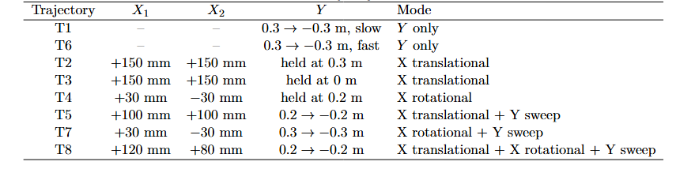
Trajectories
T1-T6 isolate simple motion types
Added T7 and T8 to improve coupling terms identifiability

Slide 5
Why multisine?
Goal: improve parameter identifiability
What
- Add broadband excitation to the nominal trajectories.
- Inject as plant-input force after the controller:
u_total = u_fb + f_ms
Why
- Smooth trajectories mainly excite low-frequency motion.
- Some parameters are weakly visible from the nominal motion alone.
- Force injection keeps the reference trajectory clean.
How
- Use the same nominal trajectory r_traj.
- Add f_ms to the plant input.
- Save u_total and q1 for identification.

Slide 6
How The Multisine Is Built
Periodic Schroeder-phase multisine
What
- s(t) = sum_i cos(2*pi*f_i*t + phi_i)
- phi_i = -i(i-1)pi/F
Why
- Multisine excites many frequencies in one simulation.
- Schroeder phases reduce crest factor: peak/RMS.
- Lower peaks make the excitation safer for the same RMS force.
How
- 1 s period -> 1 Hz frequency grid.
- Select odd frequency lines inside the candidate band.
- Normalize to unit RMS, then scale to candidate force RMS.

Slide 7
How It Is Applied And Selected
Modal mapping and diagnostic selection
What
- common: [s, s, 0] -> X translation
- diff: [s, -s, 0] -> rotation/yaw
- y: [0, 0, s] -> Y motion
Why
- Each mode excites a physically meaningful direction.
- The feedback controller can reject injected force.
- Therefore amplitude/frequency must be selected in closed loop.
How
- First simulate baseline with f_ms = 0.
- Test candidate frequency band and RMS force combinations.
- Rank by:
survival x extra motion x bandwidth
- Accept only if force and motion limits are respected.

Slide 9
Multisine Signal Construction
Periodic Schroeder-Phase Multisine, Injected as force after controller
s(t) = sum_i cos(2*pi*f_i*t + phi_i)
Frequency design
- 1 s period -> Δf = 1 Hz
- selected bins inside candidate band
- odd harmonic lines only
- trajectory padded to complete periods
Phase design
- Schroeder phases:
phi_i = -i(i-1)pi/F
- reduces crest factor = peak / RMS

Slide 10
Amplitude And Modal Mapping
Amplitude and Force Modes
Amplitude
- normalize to unit RMS
- scale to candidate force RMS
- 0.1 s cosine ramp avoids startup force jump
Modal mapping
- common: [s, s, 0] -> X translation
- diff: [s, -s, 0] -> rotation/yaw
- y: [0, 0, s] -> Y motion
MIMO detail
- mode-dependent phase shift
- reduces correlation when modes are combined

Slide 11
Closed-Loop Diagnostic Selection
Closed-Loop Diagnostic Selection
Why diagnostic?
- Feedback controller can reject injected force.
- Large force does not guarantee useful plant excitation.
Procedure
1. Simulate clean trajectory: f_ms = 0
2. Test candidate band / RMS force combinations
3. Compare with baseline:
extra motion Δq
surviving force Δu
4. Rank:
score = survival x extra motion x bandwidth
5. Accept only within:
force peak/RMS limits
position/yaw limits
velocity limits

Slide 13
Multisine design
Injected as force after controller
Schroeder-phase periodic multisine
  Resolution and padding
  Frequency bins
  Crest factor → Schroeder phase rule
Odd Harmonic Selection
Normalize multisine
Scale to candidate force level
Notes:
s(t) = sum_i cos(2*pi*f_i*t + phi_i)
phi_i = -i(i-1)pi/F

Slide 14
Multisine Signal Construction
Goal:
- Broadband excitation for parameter recovery in one simulation.
Periodic Schroeder-phase multisine:
s(t) = sum_i cos(2*pi*f_i*t + phi_i)
Schroeder phases:
phi_i = -i(i-1)pi/F
Design choices:
- 1 s period → 1 Hz frequency resolution
- integer-period padding → leakage-free signal
- selected frequency bins within candidate band
- odd harmonics only → even lines left unexcited
- Schroeder phases → lower crest factor

Slide 15
Mode-Dependent Phase Offset
Modes
And: That is why the script adds the mode-dependent phase/time shift. So the concept is:
is equivalent to a time shift by \(\tau\). In your script:
common: [s_common, s_common, 0]
diff: [s_diff, -s_diff, 0]
y: [0, 0, s_y]

Slide 16
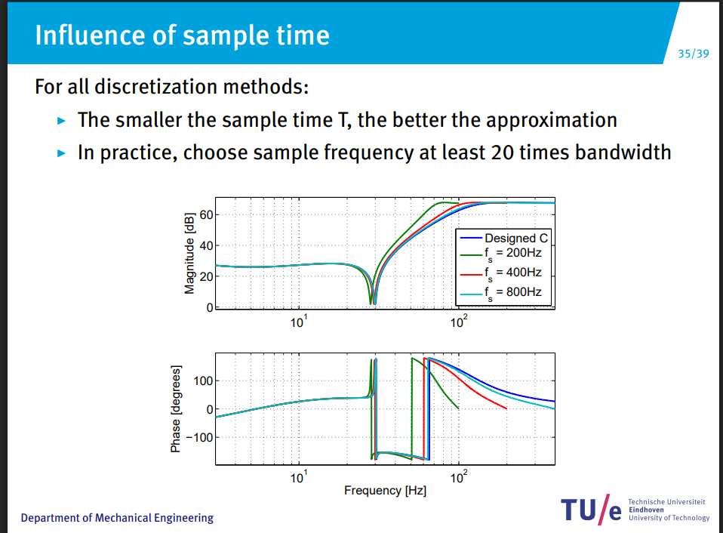
Trajectory analysis

Slide 17
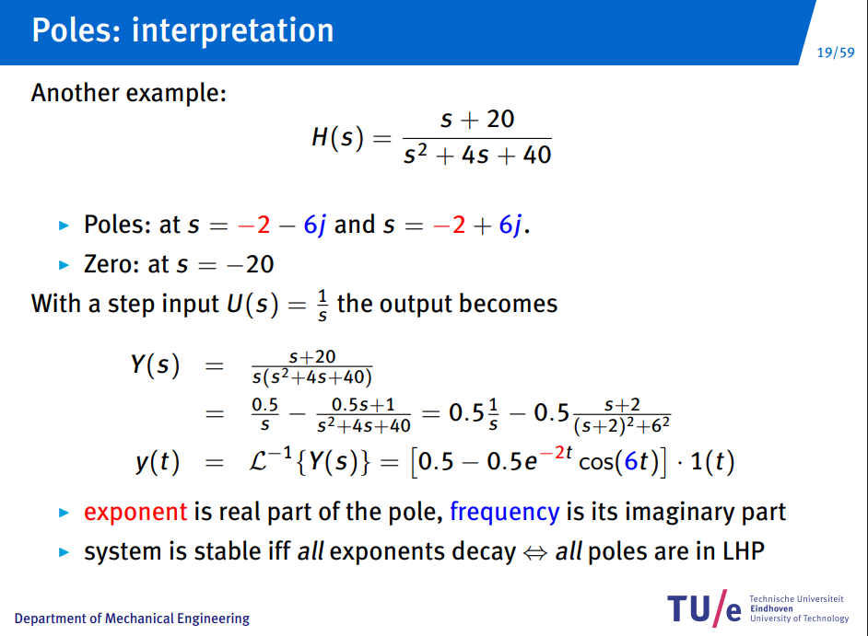

Slide 18
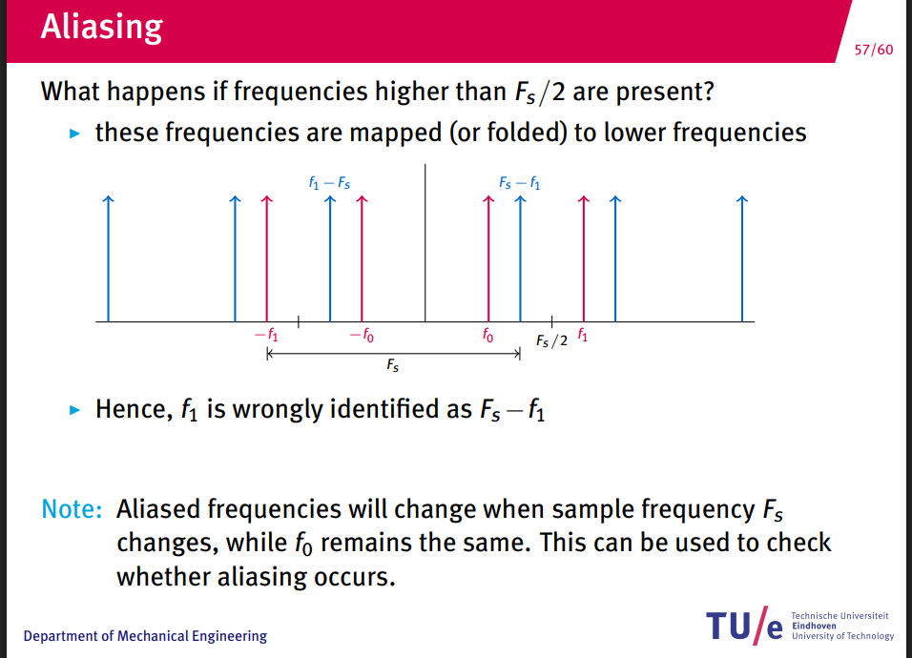

Slide 19
Problem inbetween parametric and nonparametric model closed-loop
FIM parametric. Model incomplete how to deal with augmentation/not modeled
Nonparametric approach
The cleanest defensible split:
- Phase 1 (parametric only): FIM-driven multisine for the 14 physical params — justified by Gevers et al. (2011)
- Phase 2 (augmented model): broadband excitation with uniform spectral coverage over full bandwidth, so the NN has signal everywhere.
This is the standard input design for nonlinear grey-box: Ljung (1999) §13 recommends informative inputs over the full operating range

Slide 20
Question 1
If a question needs to be answered. Make clear here what the problem/question is that needs to be answered. Questions can always be asked outside the meeting, but we may say prepare to explain what you really mean.
Some figure explaining the concept
When applicable, the same as will go in final report. Otherwise just take screenshots from relevant papers.

Slide 21
Previous questions from other slides

Slide 22
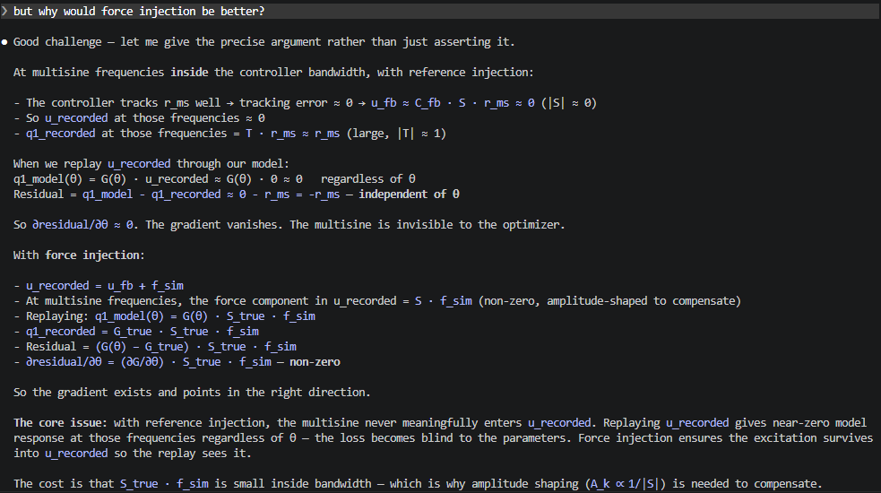
Should I use u_recorded
Helps with determining to use reference or force injection
Is there any benefit between the two

Slide 23
But if we use the data generated with the use of the FIM approach, will this not be uninformative for the unmodeled dynamics? and is a
more general nonparametric approach then not better?
Or could we focus on the coupling somehow?

Slide 24
Outline next week
What is next on the planning and how is that going to be solved
This is also where new action points are formulated. What are you going to do next week.

Slide 25
Possible Gantt-chart or Planning
To keep an overview of what the progress overall is.

Slide 26
Trajectories
8 trajectories
Plus test and validation

Slide 27
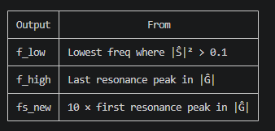
Pre-analysis
diagnostics_system.m gives you a clean, theoretically grounded
argument:
- "We inject at frequencies where |Ŝ|² > 0.1 — below that the
controller suppresses the force before it reaches the plant"
(f_low)
- "We inject up to the last resonance in |Ĝ| — above that the
plant dynamics no longer carry parameter information" (f_high)
- "We sample at 10 × f_high for BPTT" (fs_new, D)

Slide 28
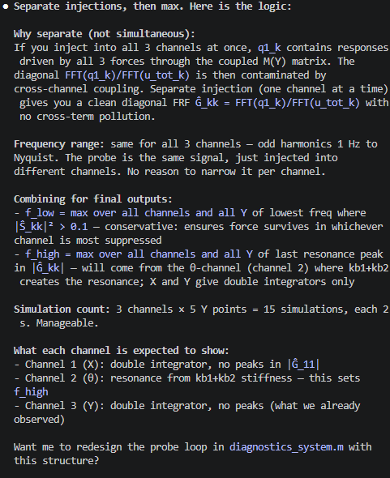

Slide 29
Here is what you need to explain, structured as a supervisor conversation:
---
Why a pre-analysis at all?
The identification multisine requires three design choices: frequency band [f_low, f_high], injection amplitude, and
phase. Without pre-analysis these are found by trial and error (scanning). On hardware you cannot scan — you need
correct parameters before touching the machine. The pre-analysis determines them from a short closed-loop probe
simulation.
---
The probe signal — and yes, Schroeder is here:
The probe is a Schroeder-phase odd-harmonic multisine (Schroeder 1970). Schroeder phases minimize the crest factor —
the ratio of peak to RMS amplitude. With ~10000 harmonics, zero-phase cosines all sum coherently at t=0, producing a
peak force of order sqrt(N_harmonics) × RMS — far above the hardware limit. Schroeder phases spread the peaks so the
crest factor stays close to 1. The FRF ratios Ŝ and Ĝ are phase-invariant — phase cancels in the ratio — so Schroeder
phases do not affect the estimates, only the force peaks.
---
What the probe estimates:
Two nonparametric frequency response functions, derived from signal ratios at the excited frequencies:
- Ŝ_c(jω) = FFT(u_modal) / FFT(f_modal) — feedback algebra: how much of the injected force survives the controller
- Ĝ_c(jω) = FFT(q_modal) / FFT(u_modal) — plant equation: how much the plant position responds per unit of surviving
force
Both are directional FRFs projected onto each mode direction. Not claimed as modal FRFs.
---
f_low — sensitivity survival threshold:
Lowest frequency where |Ŝ|² > 0.1 (-10 dB), worst-case across all modes and Y. Below f_low the controller suppresses
more than 90% of injected force — no point injecting there. Threshold 0.1 is a declared engineering choice.
---
f_high — cumulative energy criterion:
The closed-loop force-to-position response is Q/F_sim = Ĝ × Ŝ (feedback algebra). f_high is the highest frequency
where the tail energy above that frequency still contains more than 5% of the total response energy in the usable
band. Above f_high the plant response is negligible — the injected force produces no measurable output. The 5%
tolerance is a declared engineering choice.
---
A_max — 40% of hardware actuator limit:
Declared engineering choice. Leaves 60% actuator capacity for trajectory tracking and safety margin. Same for all
trajectories — conservative by construction.
---
What this replaces:
The export script scanned candidate bands [5-400 Hz] and amplitudes [10-800 N] on actual trajectory simulations and
picked winners by a scoring formula. The pre-analysis recovers the same result ([43, 195] Hz, ~300 N) directly from
the probe data without any scanning or scoring.

Slide 30
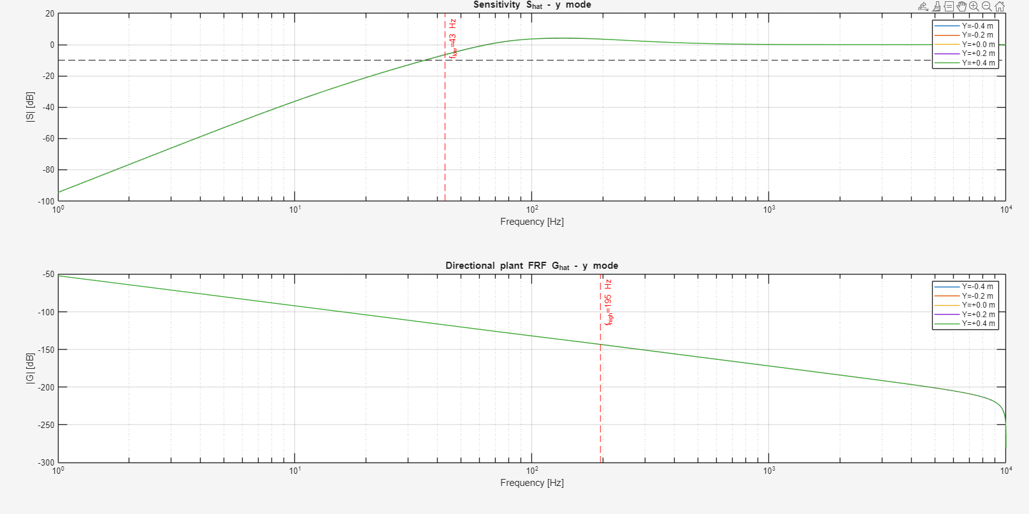

Slide 31
Multisine design

Slide 32
● Let me go through every design element needed for Step 1 and whether it is justified.
---
1. Trajectory reference design
Smooth third-order setpoint profiles (jerk-limited). Already implemented in thirdOrderSetpointETEL. Hardware limits
(position, velocity, acceleration) applied to r_total at design time.
Theory: standard motion control practice, hardware constraints. Clean.
---
2. Leakage-free period alignment
Trajectory length padded to integer multiples of T_p = 1 s so the multisine is periodic within the simulation window.
Theory: P&S Ch.2 §2.2.3 — leakage-free DFT requires integer periods. Already in export script. Clean.
---
3. Odd harmonics only
Theory: P&S Ch.4 §4.3.2 — odd harmonics allow detection of even nonlinearities. PE condition: F ≥ 7 odd bins in
[f_low, f_high]. With [43, 195] Hz and f0=1 Hz there are ~76 odd bins. Clean.
---
4. Schroeder phases
Theory: Schroeder 1970 — minimizes crest factor for a given set of harmonics. Formula: φ_k = -π·k·(k-1)/F. Clean,
citable.
---
5. Different seed per mode
The export script uses a different phase offset per mode to reduce cross-correlation between simultaneously injected
modes. This is practical but:
- It is NOT the rigorous orthogonal MIMO excitation from Pintelon et al. (2011)
- Declared limitation: signals are low-correlation, not strictly orthogonal
- For BPTT identification (not FRF estimation) strict orthogonality is not required
Honest framing: declared engineering choice, not theory-mandated.
---
6. Force injection post-controller
Theory: D-048, feedback algebra — U_total = S × F_sim. Keeps reference clean, excites plant directly. Clean.
---
7. Band [f_low, f_high] and A_max from step0_outputs.mat
Already justified by the pre-analysis. Clean.
---
8. Mode assignments per trajectory
This is the one piece with no theory. Which modes to inject into which trajectories (T4 diff only, T1 y only, etc.) is
driven by which parameters each trajectory is designed to excite. This is experiment design reasoning — physically
motivated but not from a paper.
---
Honest summary:
┌─────────────────────────────────┬───────────┬───────────────────────────────────────┐
│ Element │ Justified │ Source │
├─────────────────────────────────┼───────────┼───────────────────────────────────────┤
│ Schroeder phases │ Yes │ Schroeder 1970 │
├─────────────────────────────────┼───────────┼───────────────────────────────────────┤
│ Odd harmonics │ Yes │ P&S Ch.4 §4.3.2 │
├─────────────────────────────────┼───────────┼───────────────────────────────────────┤
│ Leakage-free periods │ Yes │ P&S Ch.2 §2.2.3 │
├─────────────────────────────────┼───────────┼───────────────────────────────────────┤
│ Band [f_low, f_high] │ Yes │ Pre-analysis (this session) │
├─────────────────────────────────┼───────────┼───────────────────────────────────────┤
│ Amplitude A_max │ Partly │ 40% rule declared │
├─────────────────────────────────┼───────────┼───────────────────────────────────────┤
│ Force injection post-controller │ Yes │ Feedback algebra │
├─────────────────────────────────┼───────────┼───────────────────────────────────────┤
│ Simultaneous multi-mode │ Partly │ Hardware limit check, not MIMO theory │
├─────────────────────────────────┼───────────┼───────────────────────────────────────┤
│ Mode assignments per trajectory │ No theory │ Physics-motivated engineering choice │
└─────────────────────────────────┴───────────┴───────────────────────────────────────┘
Everything is implementable and honestly frameable. The weak points are declared heuristics, not hidden assumptions.
Ready to write the new file?

Slide 33
Segment length
# THEORY: Lecture 3 periodic measurement (5SMB0) — integer periods required
seg_period = ceil(N_PERIODS / f_osc_min × fs_new)
Resampling _diag_fft

Slide 34
Yes, pure heuristic. Breaking it down:
- N_PERIODS / f_osc_min — "observe the slowest mode for N_PERIODS complete
cycles." No primary source derives this as a BPTT segment length criterion. It
is a physically motivated engineering choice.
- N_PERIODS = 3 — completely arbitrary. The theory doc says this explicitly: "No
primary source. 3 × T_p at f_osc_min = 3 × 0.2 s = 0.6 s."
- f_osc_min from FFT — makes it nonparametric, but does not add theoretical
backing to the formula itself.
The formula sounds reasonable but has no derivation. The only BPTT-specific
theory with a derivation in the theory doc is Aicher et al. (2019): bias decays
as β^(K−τ)/(1−β), giving T ≳ 3–5 × τ_max ≈ 4700 samples.
So the honest situation is:
┌────────────────────────────┬────────────────────────┬────────────────────┐
│ Formula │ Source │ Gives │
├────────────────────────────┼────────────────────────┼────────────────────┤
│ N_PERIODS / f_osc_min × │ HEURISTIC — no primary │ ~600 samples, fast │
│ fs_new │ source │ training │
├────────────────────────────┼────────────────────────┼────────────────────┤
│ 3–5 × τ_max × fs_new │ THEORY — Theorem 1 │ ~5000 samples, │
│ (Aicher et al. 2019) │ with derivation │ slow training │
└────────────────────────────┴────────────────────────┴────────────────────┘
You are choosing the heuristic for speed, with empirical evidence (4000 samples
recovers parameters) that the system is identifiable, and you declare the 600 as
a computational trade-off. That is a defensible position for a supervisor
conversation — as long as it is labeled HEURISTIC and not presented as theory.

Slide 36
Is this actually verified to be in the lecture?: # THEORY: Lecture 3 periodic
measurement (5SMB0) — integer periods required
seg_period = ceil(N_PERIODS / f_osc_min × fs_new)
● No, it is not verified. Applying the CLAUDE.md rule: "Literature validates only
if the formula, variable, and context match — not just the numeric constant."
Lecture 3 (5SMB0) "integer periods required" refers to: the measurement window
must be an integer multiple of the excitation period T_p to avoid spectral
leakage in the FFT. That is a statement about T_p = 1/f0 (the multisine period),
not about f_osc_min.
The formula ceil(N_PERIODS / f_osc_min × fs_new) is about covering N_PERIODS
full oscillations of the slowest natural frequency of the plant. That is a
different concept — it is not stated in Lecture 3. The variable is different
(f_osc_min vs f0), the motivation is different (observing system dynamics vs
leakage-free FFT).
So the label is wrong. The formula is either:
- HEURISTIC — "observe the slowest mode for 3 full cycles" is a reasonable
engineering rule but has no direct literature source in this exact form for BPTT
- Or needs a different, correct source if one exists
The honest label would be:
# HEURISTIC: segment spans N_PERIODS cycles of the slowest plant mode —
# ensures BPTT gradient sees complete oscillations of torsional parameters.
# N_PERIODS=3 is an engineering choice with no direct BPTT literature source.
seg_period = ceil(N_PERIODS / f_osc_min × fs_new)
Does the supervisor point to a specific paper or lecture for the FFT-based
segment criterion?

Slide 37
Pre-analysis
f_low — loop over all 3 modes × 5 Y points, run closed-loop simulation with
broadband Schroeder multisine probe, compute Ŝ = FFT(u_total) / FFT(f_sim). Find the
first frequency where |Ŝ|² > 0.1. Worst-case across all modes and Y points.
f_high — from the same simulations, compute |Ĝ × Ŝ|² = |Q/F_sim|² (closed-loop
force-to-position). Build the cumulative tail energy from high to low frequency.
Find the last frequency where the tail still contains ≥ 5% of total energy.
Worst-case across all modes and Y points.
A_max — no simulation needed. Just 0.4 × [min(F_X1, F_X2), min(F_X1, F_X2), F_Y]
where the hardware RMS limits are [916, 916, 656] N. Gives [366, 366, 262] N RMS per
mode.

Slide 39
Meeting Week 15
Parameter recovery
  The system matches the model exactly
    Only difference the parameters of the model are detuned with + / - 10%
Experiment
  Trajectories without multisine
    Are able to recover the parameters
  Current problem:
    Adding multisines on top of the current trajectories

Slide 40
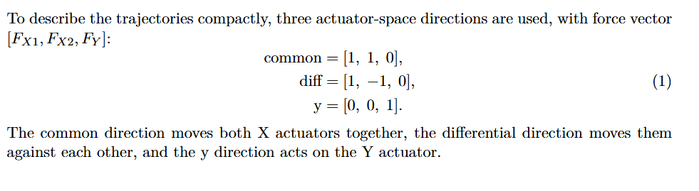
Trajectories
The different modes concept is taken from Garciá

Slide 41
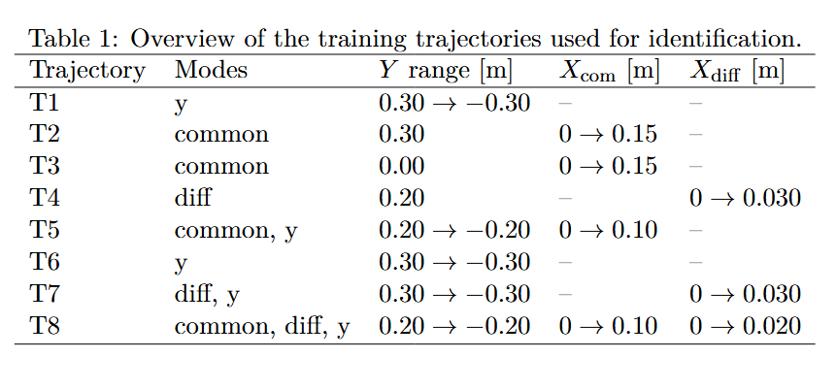
Trajectories
Note: T8, X moves in the same direction, but also creates an offset
Notes:
T1 and T6 excite only the Y direction, with T6 using a more aggressive motion
profile than T1. T2 and T3 excite common X motion at two fixed Y positions,
allowing the effect of the Y-dependent dynamics to be compared. T4 excites the
differential X direction at a fixed Y position, producing yaw motion.
T5 combines common X motion with a Y sweep, while T7 combines differential X
motion with a Y sweep. T8 combines common and differential X components during
the same Y sweep. In this case both X stages move in the same overall direction,
but with different amplitudes: $X_1$ moves to $0.120$ m and $X_2$ moves to
$0.080$ m. This gives simultaneous X translation, yaw, and Y motion.

Slide 42
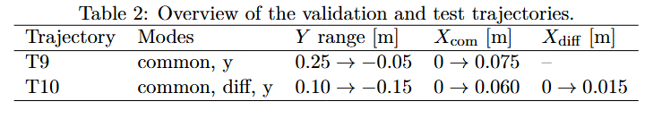
Trajectories

Slide 43
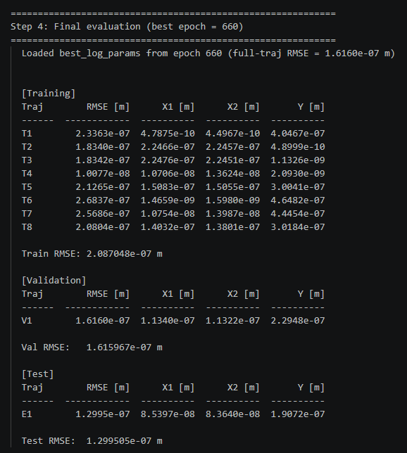
Trajectory – parameter recovery
Out of 1500 epochs, best validation RMSE for epoch 660

Slide 44
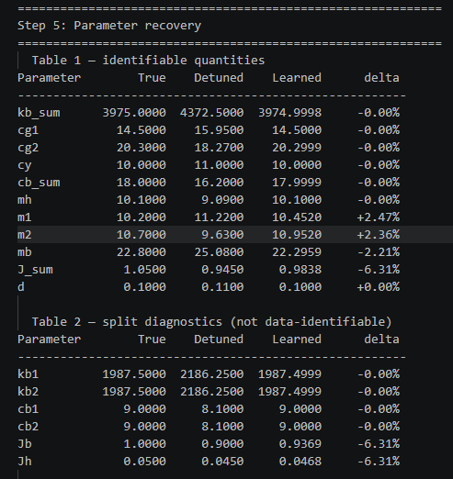
Trajectory – parameter recovery
Mainly J_sum
m1, m2 and mb
Notes:
Note: added d
Initially left out because a geometric but definitely recoverable
Lb is still left out but that one is used to decouple the system

Slide 45
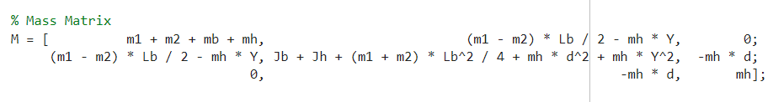

Trajectory – parameter recovery
m1+m2, and mh are not independently isolated in the mass matrix
J_sum is likely under-recovered because the theta inertia is not excited strongly enough.
Notes:
lim.diff = sin(0.1) * Lb; % max |X1-X2| yaw limit (Garcia 2013)
With Lb = 0.725 m:
text
|X1 - X2|max = sin(0.1) * 0.725 = 0.0724 m = 72.4 mm
current anti-symmetric trajectory amplitudes are:
T4/T7: X_anti_amp = 30 mm -> |X1-X2| = 60 mm -> theta ≈ 0.083 rad T8: X_anti_amp = 20 mm -> |X1-X2| = 40 mm -> theta ≈ 0.055 rad
So yes, you are staying below the 0.1 rad limit with some headroom for multisine/response overshoot.

Slide 46
Multisine

Slide 47
Multisine force injection
We use force injection because the added excitation appears directly in the recorded total plant input u_total, which is the input used for open-loop force-to-position identification.
  Closed-loop
  The model uses u_total and position output (q1)
  u_total = u_feedback + f_inj

Slide 48
Diagnostics for multisine
Needs to answer the following:
If I inject force after the controller
    which injected-force frequencies survive the closed-loop feedback
    which surviving frequencies produce measurable plant motion

Slide 49
Diagnostics for multisine
Diagnostic Probe
A broadband periodic Schroeder multisine is injected as an additive force after the controller in the Simulink model. (odd frequencies from 1 Hz up to just below Nyquist)
The multisine repeats every 1 s, so it excites frequencies that fit exactly in that time window, such as 1, 3, 5, ... Hz. These frequencies align with the FFT grid, which allows clean frequency-response estimates.
The same 1 s multisine is repeated twice. The first repetition is not used for the estimate, because the system may still be reacting to the sudden start of the excitation. The second repetition is used for the FFT, because the response is closer to the steady response to the repeated multisine.
Notes:
odd frequencies from 1 Hz up to just below Nyquist
If you take an FFT of a signal segment with length T seconds, the FFT frequency spacing is:
Δf = 1 / T
Your diagnostic multisine excites odd frequencies:
The FFT grid is the set of frequency points returned by the FFT. With a 1 s analysis window, these points are spaced by 1 Hz. The multisine is designed to excite frequencies that lie exactly on this grid.
The same 1 s multisine is repeated twice. The first repetition is not used for the estimate, because the system may still be reacting to the sudden start of the excitation. The second repetition is used for the FFT, because the response is closer to the steady response to the repeated multisine.

Slide 50
Diagnostics for multisine
Diagnostic Probe
For each force direction m, the MIMO signals are projected onto that same direction:
F_m,inj(f) = injected force in direction m
U_m,total(f) = total plant input force in direction m
Q_m(f) = measured q1 motion in direction m
This gives a directional SISO-like experiment for each mode: common, diff, and y.
Notes:
odd frequencies from 1 Hz up to just below Nyquist
If you take an FFT of a signal segment with length T seconds, the FFT frequency spacing is:
Δf = 1 / T
Your diagnostic multisine excites odd frequencies:
The FFT grid is the set of frequency points returned by the FFT. With a 1 s analysis window, these points are spaced by 1 Hz. The multisine is designed to excite frequencies that lie exactly on this grid.

Slide 51
Diagnostics for multisine
Estimated Quantities
S_in,m(f) = U_m,total(f) / F_m,inj(f)
S_in,m is a directional closed-loop input-sensitivity estimate. It shows how much of the injected post-controller force remains in the total plant input after feedback action. It is not the full MIMO sensitivity matrix.
G_m(f) = Q_m(f) / U_m,total(f)
G_m is a directional plant FRF estimate. It shows how much measured q1 motion is produced per actual total actuator force.
Their product gives the effective injected-force-to-motion frequency response:
G_m(f) S_in,m(f) = Q_m(f) / F_m,inj(f)
This response is used to select the useful multisine frequency band.
The diagnostic is repeated for several frozen Y operating points, and the final frequency bounds are chosen conservatively as the worst case across directions and operating points.
Notes:
Because the two ratios share the middle term, U_m,total(f).
You define:
S_in,m(f) = U_m,total(f) / F_m,inj(f)
and:
G_m(f) = Q_m(f) / U_m,total(f)
Now multiply them:
G_m(f) S_in,m(f) = [Q_m(f) / U_m,total(f)] * [U_m,total(f) / F_m,inj(f)]
The U_m,total(f) cancels:
G_m(f) S_in,m(f) = Q_m(f) / F_m,inj(f)
So the product tells directly:
how much measured motion Q_m you get per injected force F_m,inj

Slide 52
Diagnostics for multisine
Frequency Band Selection
The lower bound f_low is chosen from the directional input-sensitivity estimate:
S_in,m(f) = U_m,total(f) / F_m,inj(f)
It marks the first frequency where the injected force is no longer strongly rejected by the feedback loop.
Criterion:
|S_in,m(f)|² > 0.1 (at least 10% of the injected force power remains in the total plant input)
The final f_low is selected conservatively as the worst case across all force directions and Y operating points.
Notes:
That means at least about 10% of injected force power survives, or equivalently:
means the power-like ratio is larger than 0.1, or 10%.
f_low is the first frequency where at least 10% of the injected force power, or about 32% of the force amplitude, remains in the total plant input.

Slide 53
Diagnostics for multisine
Frequency Band Selection
The upper bound f_high is chosen from the effective injected-force-to-motion response:
G_m(f) S_in,m(f) = Q_m(f) / F_m,inj(f)
This quantity tells how much measured q1 motion is produced by the injected force.
The script applies a tail-energy rule to:
|G_m(f) S_in,m(f)|²
Starting from high frequencies, it computes how much response energy remains above each candidate frequency. f_high is chosen as the highest frequency for which the remaining tail energy is still at least 5% of the total response energy in the usable band.
Above f_high, the injected force is assumed to add little useful motion response for identification.
Notes:
Because G_m(f) only tells you:
motion per actual plant input force
but it does not tell you whether your injected force actually reaches the plant.
Recall:
G_m(f) = Q_m(f) / U_m,total(f)
So G_m answers:
If the plant receives force at this frequency, how much motion does it produce?
But your design question is different:
If I inject force after the controller, how much motion do I get?
For that, you need the full path:
F_m,inj -> U_m,total -> Q_m
That is:
S_in,m(f) = U_m,total(f) / F_m,inj(f) G_m(f) = Q_m(f) / U_m,total(f)
So:
G_m(f) S_in,m(f) = Q_m(f) / F_m,inj(f)
Example:
Frequency A: G_m is large, but S_in,m is near zero. The plant would move if force reached it, but the controller cancels the injected force. So injected force gives little motion. Frequency B: G_m is moderate, and S_in,m is large. The injected force survives and produces measurable motion. This is more useful for the multisine.
So for choosing f_high, G_m alone is incomplete. You need G_m S_in,m because the final multisine is not directly choosing U_total; it is choosing F_inj.
Simple wording:
G_m only describes the plant once force reaches it. G_m S_in,m describes the full closed-loop path from the injected force to the measured motion, which is the quantity relevant for designing the injected multisine.
response_energy(f) = |G_m(f) S_in,m(f)|²
Since:
text
G_m(f) S_in,m(f) = Q_m(f) / F_m,inj(f)
this means:
text
response_energy(f) = |Q_m(f) / F_m,inj(f)|²
The script defines a usefulness measure per frequency as |G_m S_in,m|², i.e. squared motion response per injected force. It then computes the cumulative remaining high-frequency contribution. f_high is chosen so that frequencies above f_high contain only about 5% of the total contribution, meaning the selected band from f_low to f_high contains about 95%.
Therefore, f_high is an energy-based cutoff, not an explicit resonance-peak detector.

Slide 54
Multisine design
Purpose:
Add a designed force multisine on top of the nominal motion trajectories.
Inputs from diagnostics
f_low = lowest useful injected-force frequency
f_high = highest useful injected-force frequency
A_max = RMS force budget per mode (we take 40% of the max from the hardware limits)
Design choice:
Final multisine only excites frequencies inside [f_low, f_high].

Slide 55
Multisine design
Each experiment first defines a reference motion:
r(t) = [X1_ref(t), X2_ref(t), Y_ref(t)]
A feedback controller tracks this reference:
u_q1(t) = Cfb (r(t) - q1(t))
The multisine is injected after the controller:
u_total(t) = u_q1(t) + f_sim(t)
The controller is designed per trajectory at:
Y_op = Y_initial
and then kept fixed during the trajectory.
Notes:
Meaning:
r(t) defines the intended motion
f_sim(t) adds extra force excitation for identification
q1(t) is the simulated plant response

Slide 56
Multisine design
Mode-Based Excitation
The force multisine is applied in physical force directions:
common = [1, 1, 0] symmetric X force
diff = [1, -1, 0] differential / yaw force
y = [0, 0, 1] Y force
For multi-mode trajectories:
all active modes are injected simultaneously

Slide 57
Multisine design
Schroeder Multisine Construction
For each active mode, a periodic odd-harmonic Schroeder multisine is generated: f_low <= f_k <= f_high
Only odd harmonic lines are used
  ..., f0, 3f0, 5f0, ...
  f0 = 1 Hz
Schroeder phases are used to reduce crest factor
Each trajectory is padded to an integer number of 1 s periods:
  N is a multiple of N_period
  This keeps the multisine periodic and leakage-free.
Notes:
Padding extends the final hold of the reference trajectory. The commanded position remains constant, but the force multisine continues, so the experiment ends after a complete multisine period.

Slide 58
Multisine design
Each active mode receives a different phase seed:
Purpose:
  reduce correlation between simultaneously injected modes
Train validation and test phase also differs (frequency stays the same)
Note:
  Different seeds are a decorrelation heuristic.
  They do not make the modes strictly orthogonal.
Notes:
The base Schroeder phase is:
phi = -pi * idx .* (idx-1) / F;
Then the script adds a seed-dependent phase shift:
phi = phi + 2*pi*(k*f0)*(seed-1)/(7*f_high);
So the frequencies stay the same, but the phases change.

Slide 59
Multisine design
Enforce Hardware limits
position and velocity limits on q1
acceleration limits on reference r
peak force limits on u_total
RMS force limits on u_total

Slide 60
Multisine design

Slide 61
Multisine problems?
Issue with calculating the states for when multisine is added on top?
Only using position for that so I don’t know why that would be the case?...
But maybe

Slide 62
Multisine output
Identical trajectories as without multisine. Cannot recover parameters with:
  Segment length 650
  Segment length 4000
Notes:
Currently not using a proper method to find best segment length
Step response hard time because…
FFT not used currently
Planning on using FRFs instead..

Slide 63
Multisine output
Identical trajectories only difference with multisine
  Segment length 650 same as without multisine
  Segment length 4000 also terrible results
Currently not using a proper method to find best segment length
  Step response hard time because…
  FFT not used currently
  Planning on using FRFs instead..
Notes:
Currently not using a proper method to find best segment length
Step response hard time because…
FFT not used currently
Planning on using FRFs instead..

Slide 64
Closed-loop
MIMO
LPV
System identification
Before or after controller multisine injection
Controller… ruleofthumb currently

Slide 65
Multisine after controller
Post-controller multisine injection is preferred when the identification data should represent plant force input to motion output, because the total applied force can be logged and used directly as model input. The drawback is that the feedback controller attenuates the resulting motion through the disturbance sensitivity path, so low-frequency excitation inside the feedback bandwidth may be weak. Reference injection gives stronger low-frequency output excitation but identifies the closed-loop reference-to-output path unless the controller force is explicitly reconstructed and used.

Slide 66
Settle time
Tsettle = max(Tsettle_q, Tsettle_u_total)

Slide 67
LTI MIMO closed-loop system.

Slide 68
Show output without multisine
Have to look at the jsum why not identifiable

Slide 69
Originele multisine bepalen..
Segment length 650 werkte wel zonder multisine maar niet met…
Probleem ligt aan…

Slide 70
Step response
Too many issues because…
Closed-loop is the main issue, lpv, mimo

Slide 71
FRF
Design choices

Slide 72
Question
Multisine is only causing issues. Need to design around slowest dynamics, what is the best approach for this?
  Step response how to do for closed-loop, mimo, LPV?

Slide 73
Should I use u_recorded
Helps with determining to use reference or force injection
Is there any benefit between the two

Slide 74
New joint meeting

Slide 75
To do
Fix experiment design for multisine
Afterwards can move on to augmenting the system

Slide 76
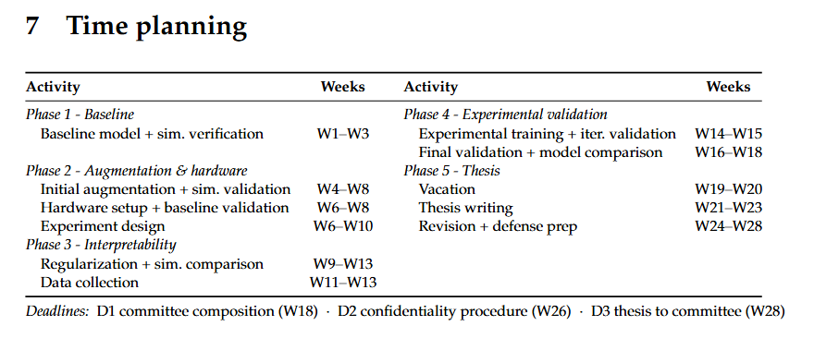
Planning – Week 7

Slide 77
Planning – Week 7

